Slide 1

Cognitive Radio Spectrum Sensing and Allocation: A Low-Complexity Deep Learning Approach
COE491 Senior Design Presentation
Advised By:
Dr. Mohamed AlHajri
Dr. Taha Landolsi
Presented By:
Hamza Ahmed Abushahla, 90279
Ghanim Abdulla Alarai Al-Ali, 89804
Sultan Khalid Abdalla, 89987
Muhammad Ismail Sadaqat, 90340
Notes:
Hamza

Slide 2
Table of Contents
Motivation
Design Objectives
Literature Review
Implementation
Problem Statement
Conclusion
System Testing and Validation
Future Work
Notes:
Hamza

Slide 3

Problem Statement
Exponential growth of mobile and IoT devices
Unprecedented demand for radio frequency (RF) spectrum [1]
Pushing 4G and 5G bands to their limits [1]
Licensed spectrum bands often underutilized [5]
Congestion, interference, and performance issues
Spectrum scarcity threatens communication system efficiency [7]
Notes:
Hamza

Slide 4
Motivation
Cognitive radio (CR) is a significant and active research topic (Approx. 30K Publications)
Deep learning (DL) improves spectrum sensing (SS)
Adapts to various spectral patterns and interference
Intersects with embedded Machine Learning (ML), energy-efficient computing, and sustainability
Notes:
Ghanim

Slide 5
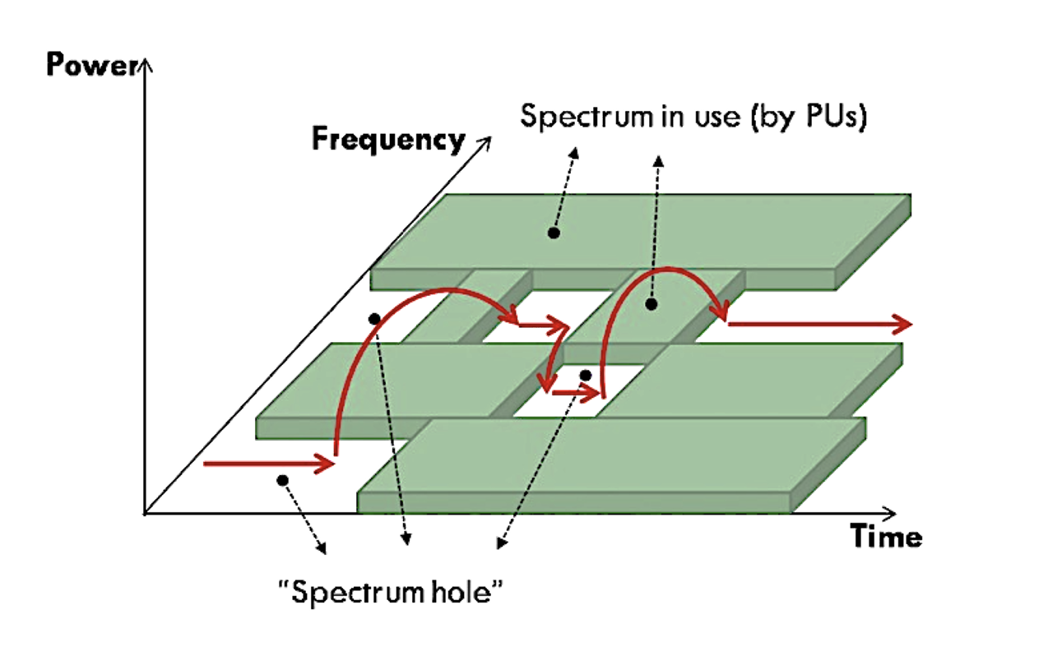
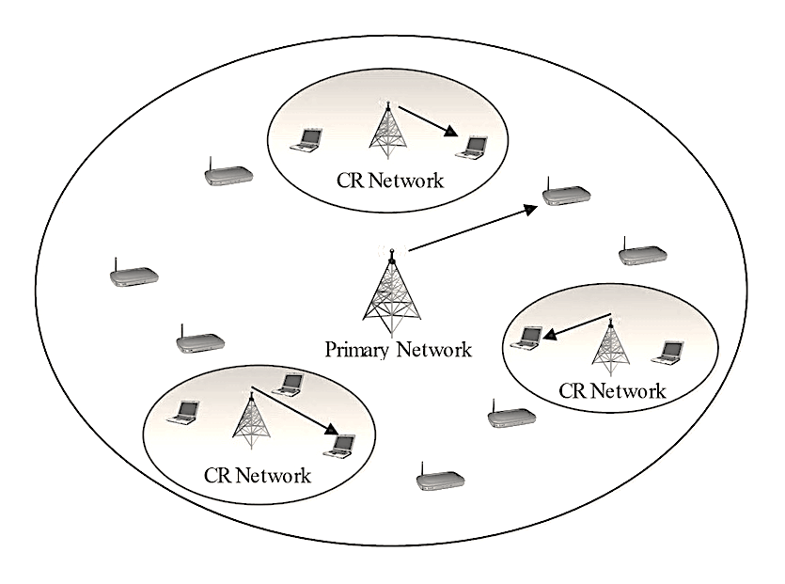
Literature Review
SS Approaches [8, 9]
Conventional SS techniques
ML-based SS: Supervised & Unsupervised
DL-based SS: Convolutional Neural Networks (CNNs)
CR Fundamentals [7, 10]
Spectrum holes concept
CR Networks: Centralized & Distributed
RF spectrum users: Primary Users (PUs) & Secondary Users (SUs)
Fig. 1. Spectrum hole concept [7]
Fig. 2. CR networks within a primary network [10]
Notes:
Ghanim

Slide 6
Literature Review
Hardware Platforms [42, 43]
Low-cost and efficient hardware platforms for SS
Microcontrollers, RF transmitters, and USB-software defined radio (SDR)
Embedded ML and DL-based SS algorithms
Spectrum Allocation [35, 40]
Dynamic spectrum allocation (DSA) in centralized CR networks
Processes SU requests on a first-come-first-serve (FCFS) basis
Allocates spectrum holes to SUs based on real-time availability
Notes:
-S.K

Slide 7

Design Objectives
A low-complexity CNN-based algorithm for SS
Centralized CR network architecture
Queueing model for DSA
Hardware implementation to showcase algorithm in a practical scenario
Notes:
-S.K

Slide 8
Implementation: Hardware
Central node
PU node
SU node
RTL-SDR
RF Transceivers
Sensors
System Interface
Fig. 3. System block diagram
Notes:
S.K

Slide 9
Implementation: Software
Frequency Division Multiple Access (FDMA)
Control Channel: 440MHz
In-phase & quadrature (I/Q) samples
Compressed CNN-based SS algorithm
DSA queue for SU spectrum utilization
Fig. 3. System block diagram
Notes:
M.S

Slide 10
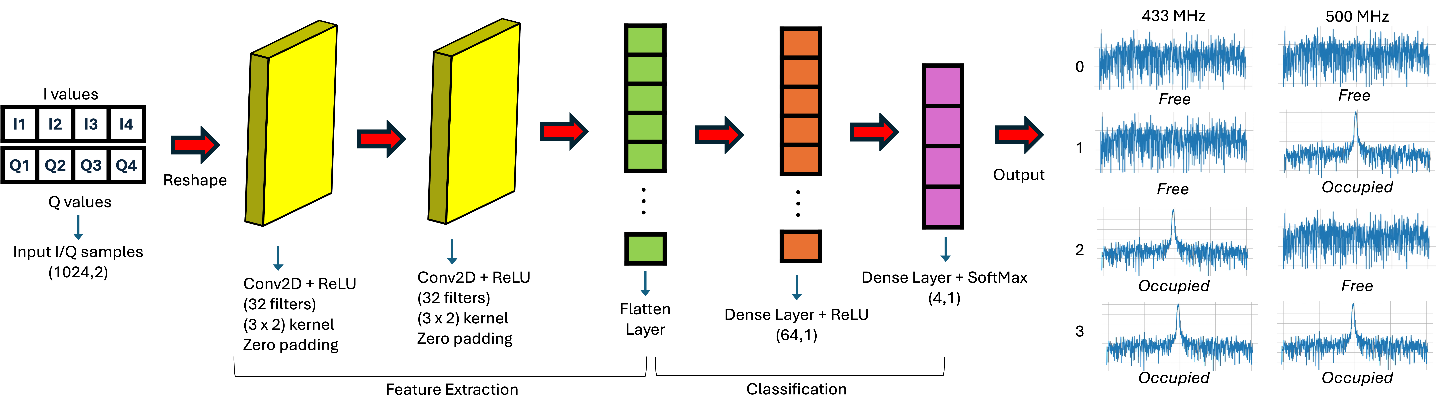
Implementation: CNN-Based DL Model
Fig. 4. Network architecture of the CNN model
Notes:
M.S

Slide 11
Implementation: Model Training
Acquired “SDR Dataset” [43]
Non-synthetic dataset emulating real Wi-Fi communications
I/Q samples from four 5-MHz-wide channels (20 MHz total)
Captured using USRP N210 SDRs via GNU Radio
Dataset divided: 80% for training, 10% for validation, 10% for testing
Our Collected Dataset
300,000 I/Q samples from 433 MHz and 500 MHz
Captured through GNU Radio using two RTL-SDR antennas
Arduino devices acted as PU transmitters for four scenarios
Energy detection used to determine frequency occupancy
Dataset divided: 80% for training, 10% for validation, 10% for testing
Notes:
Ghanim

Slide 12
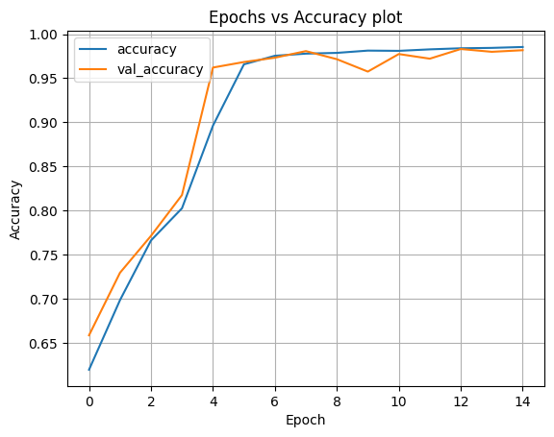
Implementation: Training, Validation, and Testing Results
Acquired “SDR Dataset”:
Trained on 287,971 data samples over 15 epochs
Achieved high accuracy of 98.54% with low loss of 0.0473
Tested on separate set of 31,997 data samples
Attained high accuracy of 93.73% with loss of 0.2255
Fig. 5. Accuracy plot on the acquired SDR dataset
Notes:
M.S

Slide 13
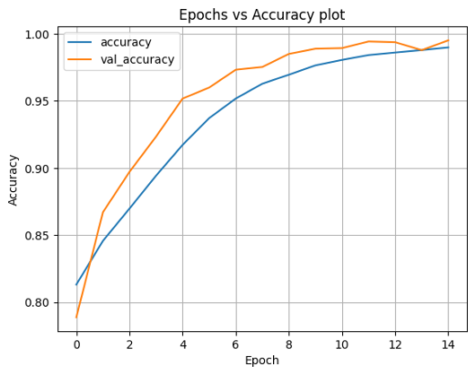
Implementation: Training, Validation, and Testing Results
Our Collected Dataset:
Trained on 240,000 data samples over 15 epochs
Achieved exceptional accuracy of 98.98% with loss of 0.0190
Tested on distinct set of 60,000 data samples
Achieved impressive accuracy of 96.43% with loss of 0.3057
Fig. 6. Accuracy plot on the collected dataset
Notes:
M.S

Slide 14
Implementation: Model Compression Results
Compression using post-training quantization
Reduces the number of bits required to represent model weights
Lowers memory complexity of DL model
Crucial for deployment on resource-constrained devices
Quantization achieved an 75% reduction in model size with no loss in accuracy
Table 1. Performance on the acquired SDR dataset
Model | Accuracy (%) | Size (MB)
Baseline (Float 32) | 93.73 | 4.23
Float 16 | 93.74 | 2.11
Float 8 | 91.74 | 1.06
TF Lite Float 16 | 93.77 | 2.02
Table 2. Performance on the collected dataset
Model | Accuracy (%) | Size (MB)
Baseline (Float 32) | 96.43 | 16.80
Float 16 | 96.43 | 8.40
Float 8 | 96.40 | 4.2
TF Lite Float 16 | 96.18 | 8.02
Notes:
Hamza

Slide 15
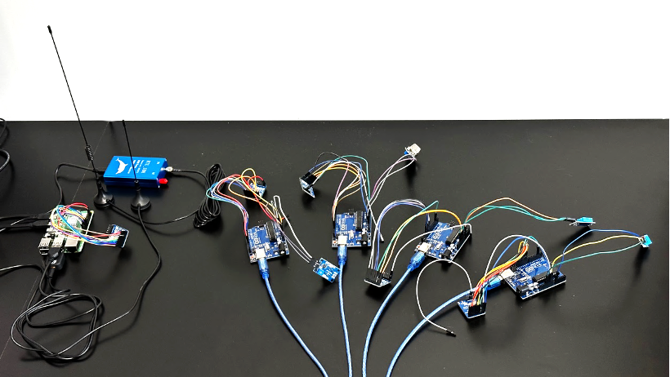
Implementation: Experimental Setup
Central Node
and Transceiver
PU1 Node
SU1 Node
RTL-SDR Dongle and 2 Antennas
PU2 Node
DHT-11 Sensors
MQ-135 Sensors
SU2 Node
Fig. 7. Hardware experimental setup

Slide 16
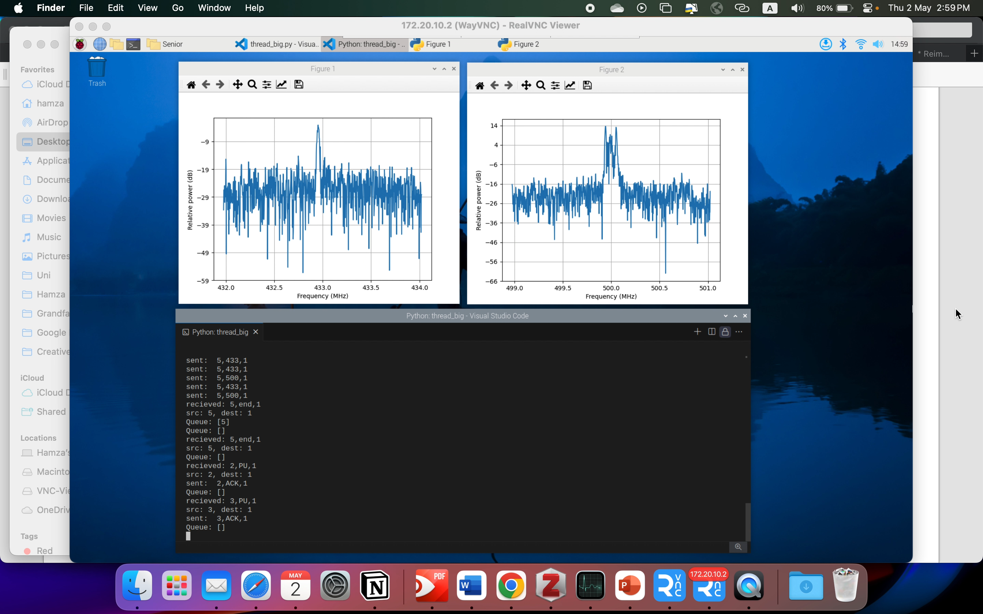
Implementation: System Interface
Fig. 8. System interface showing PU and SU activity
Notes:
Hamza

Slide 17
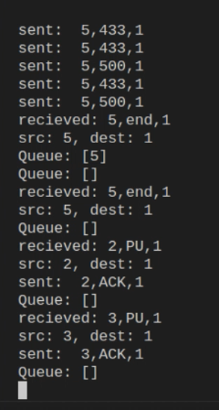
Implementation: System Interface
Fig. 8. System interface showing PU and SU activity

Slide 18
System Testing and Validation
Occupied Spectrum Scenarios:
Tested system response to single and simultaneous PU transmissions.
Verified DL model’s accuracy in identifying occupied channels.
Unoccupied Spectrum Scenarios:
Examined system’s handling of no PU activity and multiple SU requests.
Confirmed correct channel allocation by the central node.
Dynamic Changes in Spectrum Occupation:
Assessed system’s adaptability to sudden PU arrivals during SU transmissions.
Verified reallocation of channels based on DL model updates.
Notes:
Hamza

Slide 19
Conclusion
Develop an intelligent spectrum sensing and allocation system
Utilize advanced DL algorithms and CR techniques
Optimize utilization of available frequency bands
Translate research into a practical implementation
Spectrum scarcity is a growing challenge
Notes:
Ghanim

Slide 20
Future Work
Further refine and improve the DL-based SS and allocation system
Deploy it in real-world scenarios to validate and improve its performance
Explore other DL-based architectures and optimization techniques
Adapt the DL-SS system to meet the demands of future 6G networks
Notes:
-S.K

Slide 21
Thank you for listening!

